Slide 1
VARTA WIN200
The UC Client for Seamless Collaboration

Slide 2
UNIFIED COMMUNICATIONS
VARTA WIN200 – The UC Client for Seamless Collaboration

Slide 3
Agenda
VARTA WIN200 – The UC Client for Seamless Collaboration
VARTA WIN200
VARTA WIN200 At a Glance
VARTA WIN200 Target Audience
VARTA WIN200 Applications and Benefits
VARTA WIN200 Sales Pitch
VARTA WIN200 Technical Specifications
VARTA WIN200 Screens
VARTA WIN200 System Requirements

Slide 4
UNIFIED COMMUNICATIONS
VARTA WIN200 – At a Glance
Windows Desktop based UC Client for Seamless Collaboration
Corporate Directory Integration
1000 DSS and 600 BLF Keys for Monitoring
Popup Window for Incoming Message and Call
Comprehensive Call Management - Hold, Transfer, Forward, DND
Presence Sharing, Instant Messaging and Outlook Integration
Video Calling
Drag and Drop Conference
Contact Grouping
Works with SARVAM UCS and Existing IP-PBX ETERNITY V12R5.2 onwards

Slide 5
Target Customers
UNIFIED COMMUNICATIONS
VARTA WIN200 – Target Audience
Corporates
Hotels
Hospitals
Call Centers

Slide 6
UNIFIED COMMUNICATIONS
VARTA WIN200 – Applications and Benefits
Call Management Made Easy
Comprehensive Call Handling Capabilities with Transfer, Conference, Hold, Forward and DND
One Office – One Number, Seamless connectivity with Office Employees even on the Move
Flexibility with Integration of VARTA WIN200 with your IP Desk Phone or Mobile App and Avail Benefits of Same Extension Number
All Contacts in One Location with Corporate Global Directory Integration for Easy and Quick Access
Increase Staff Productivity with Real-time UC Features
• One Touch Access to Extension Numbers with 1000 Direct Station Selection Keys
• Monitor Real-time status of Employees with 600 Busy Lamp Field Keys
• Presence Sharing and Instant Messaging for Live Status Updates and Quick Chats
• Drag and Drop Conference for Meetings Offers Convenience to the Users and Saves Time
• Contact Grouping for Easy Search and Quick Connectivity

Slide 7
UNIFIED COMMUNICATIONS
VARTA WIN200 – Applications and Benefits
Invest in Your Collaboration Solution for Lower TCO and Higher ROI
Reduce Mobile Charges through Desktop Computer Extension while Outside State or Country
Use Multi-party Audio Conferencing and Drag and Drop Transfer for Enhanced Productivity leading to Higher ROI
Protect your Investment by Utilizing Existing Desktop Computer as an Office Extension
Intuitive Interface and Personalization Leads to Customer Convenience
• Search Dial Pad Allows to Type Contact Name or Extension Number Directly making it Easy to Use and Manage
• Intuitive Icons and Graphical Designs Enable Users to Identify and Control Features Instantly making it Easy to Use
• Personalize your Interface by Marking Favorites Contacts and Contact Grouping for Quick and Easy Connectivity
• Get Call Logs and Incoming Call Pop-up Notifications for Customer Convenience

Slide 8
UNIFIED COMMUNICATIONS
VARTA WIN200 – Applications and Benefits
Multi-tasking becomes Easier
VARTA and Outlook Screen Merged into One
Convenience of Dialing to Outlook Contacts
Presence Status Visible from the Outlook Screen
Quick Communication through Emoticons and Intuitive Dial Pad
Presence Status Directly Updated during Meetings
Personalized Dialing Experience

Slide 9
UNIFIED COMMUNICATIONS
VARTA WIN200 – Sales Pitch
Upgrade your Existing IP-PBX with VARTA WIN200 for Unified Communications
Convert your Desktop Computer (PC) into your Deskphone and Manage your Calls easily
Monitor your Employees (Who is calling whom and Status Check) with 600 Busy Lamp Field Keys
One Touch Connectivity to all your Employees and Colleagues with 1000 DSS (Shortcut) Keys
Pop-up Notifications of Incoming Calls for Better Response to Customer
Keep Same Extension Number of Desk Phone, Mobile and Desktop UC Client and Remain Connected with the Office Communications

Slide 10
UNIFIED COMMUNICATIONS
VARTA WIN200 – Technical Specifications
Features | VARTA eSSENTIAL | VARTA pROFESSIONAL | VARTA cOLLABORATION
Call Management - Call, Hold, Transfer, Forward, DND & Intercom | Y | Y | Y
Multi-Party Audio Conf. | Y | Y | Y
Presence Sharing & IM | Y | Y | Y
Favourites & Contact Grouping | Y | Y | Y
Blind Transfer | Y | Y | Y
Video Call | Y | Y | Y
Voicemail | Y | Y | Y
Corporate Directory Integration | Y | Y | Y
Menu options - Call Pickup, Paging, Message wait, Call Retrieve, Alarm and Reminder, Dynamic Lock, Dial-In Conference, CLIR, Room monitoring and Call Supervision | Y | Y | Y
Call Screening - ACB, Forced Answer, Global Hold, General Call Park, Call Chaining, Call Recording, IR & Barge-IN | Y | Y | Y
Handover |  | Y | Y

Slide 11
UNIFIED COMMUNICATIONS
VARTA WIN200 – Technical Specifications
Features | VARTA eSSENTIAL | VARTA pROFESSIONAL | VARTA cOLLABORATION
Multi-party Audio Conference |  | Y | Y
Drag and Drop Transfer & Conference |  | Y | Y
Drag and Drop Conference |  | Y | Y
1000 DSS & 600 BLF Keys |  | Y | Y
Call Transfer & Direct Call to other User's Voicemail |  | Y | Y
Click-to-Call |  |  | Y
Outlook Calendar Integration |  |  | Y
Outlook Call Integration |  |  | Y
Outlook IM Integration |  |  | Y

Slide 12
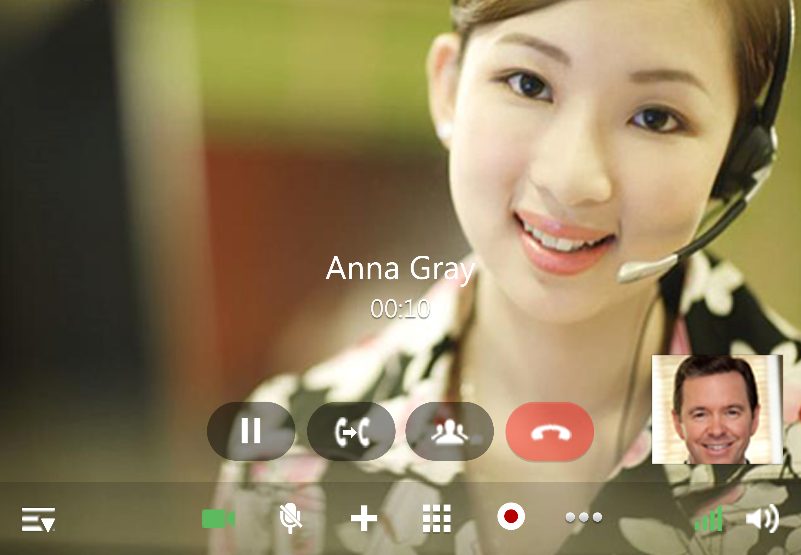
UNIFIED COMMUNICATIONS
VARTA WIN200 – Video Calling

Slide 13
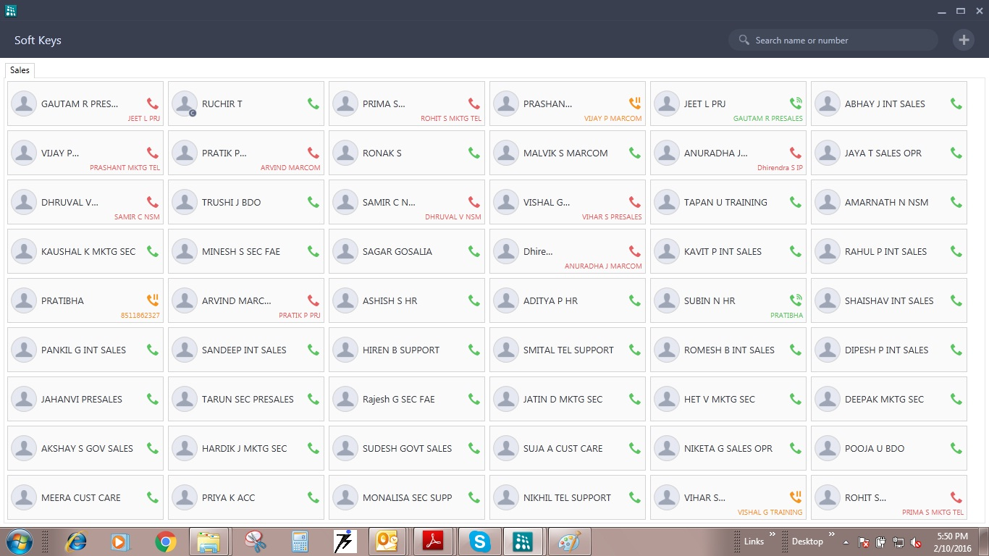
UNIFIED COMMUNICATIONS
VARTA WIN200 – DSS & BLF Keys with Name Screening

Slide 14
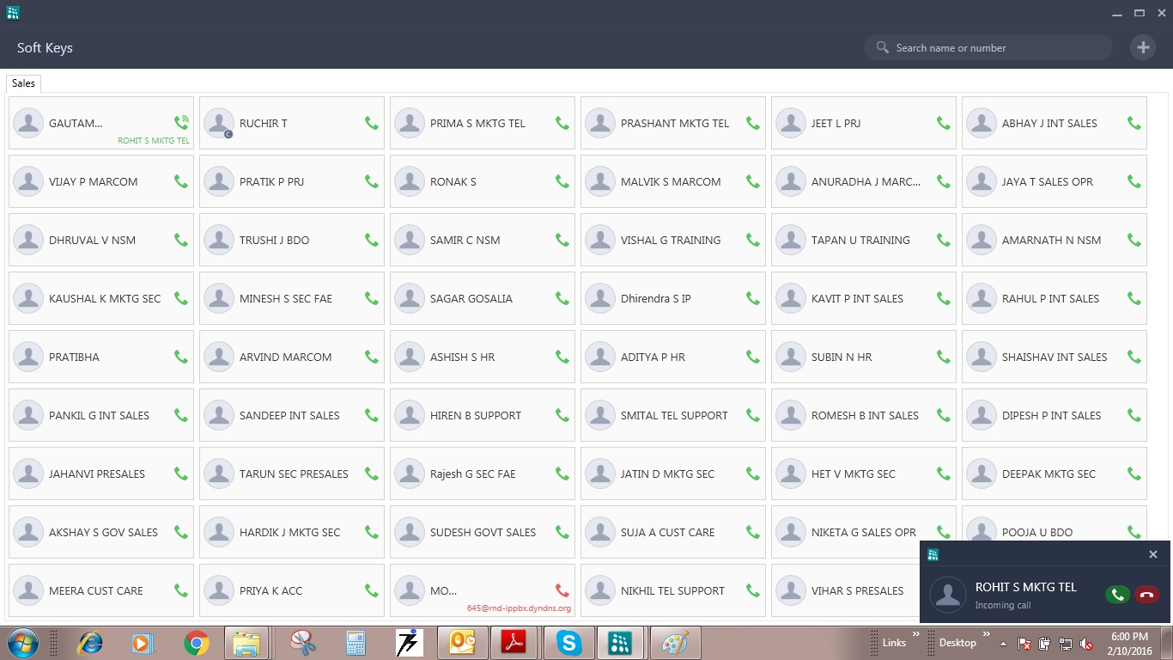
UNIFIED COMMUNICATIONS
VARTA WIN200 – Pop-up Notifications Screen

Slide 15
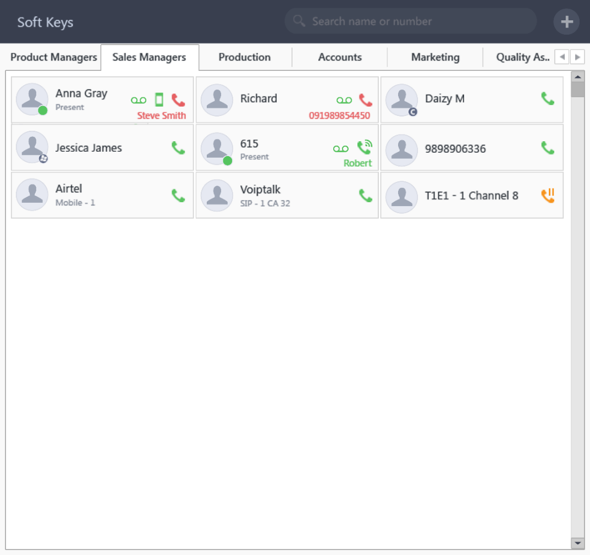
UNIFIED COMMUNICATIONS
VARTA WIN200 – Contact Grouping Screen

Slide 16
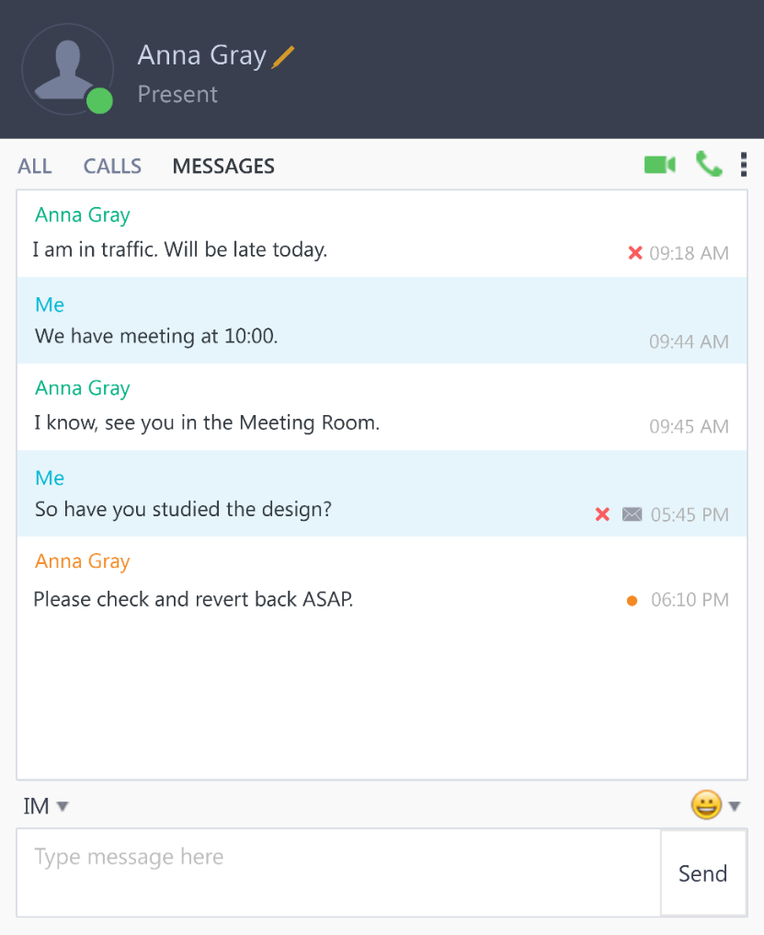
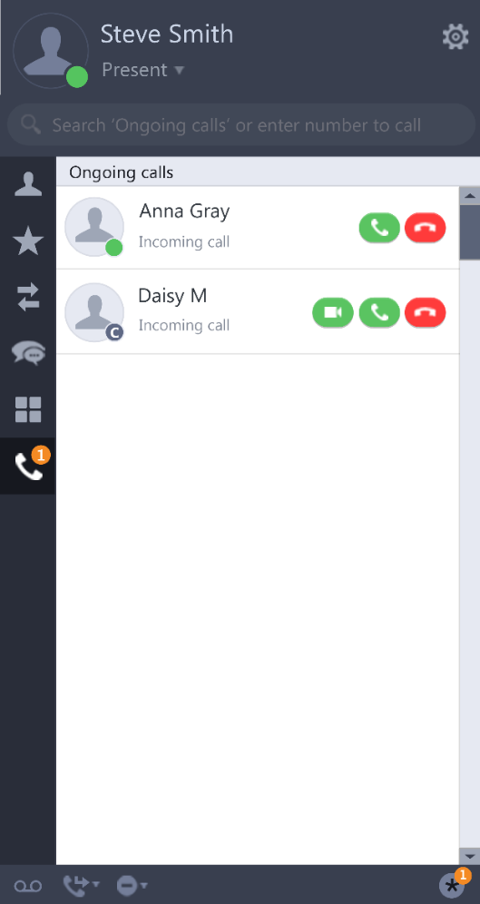
UNIFIED COMMUNICATIONS
VARTA WIN200 – Instant Messaging and On Going Call Screen

Slide 17
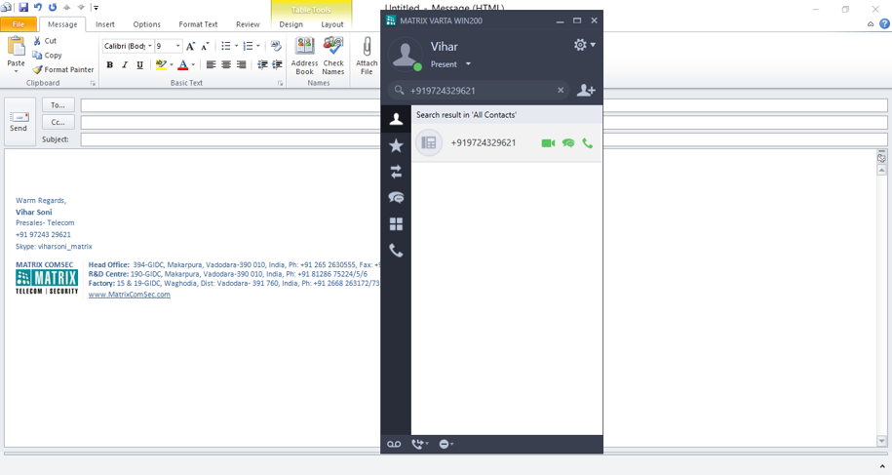
UNIFIED COMMUNICATIONS
VARTA WIN200 – Outlook Integration Screen

Slide 18
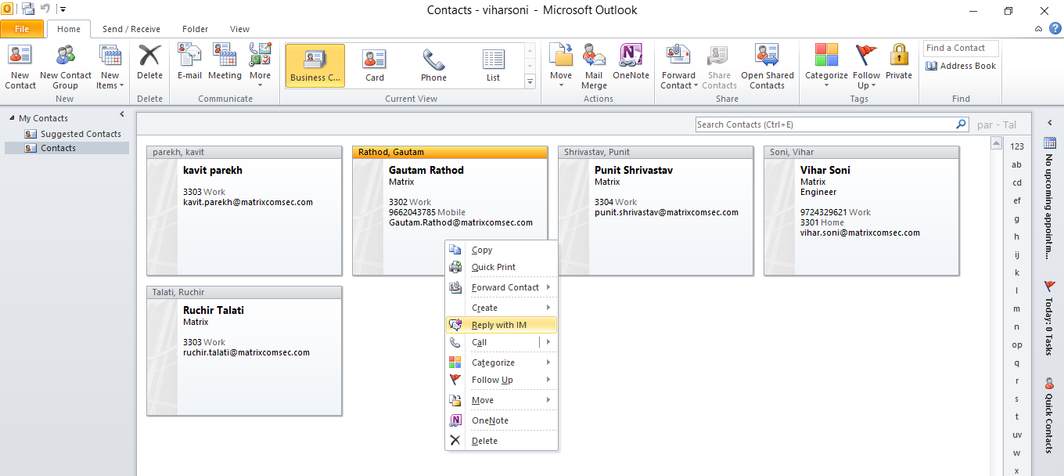
UNIFIED COMMUNICATIONS
VARTA WIN200 - Call from Outlook and Reply with IM Screen

Slide 19
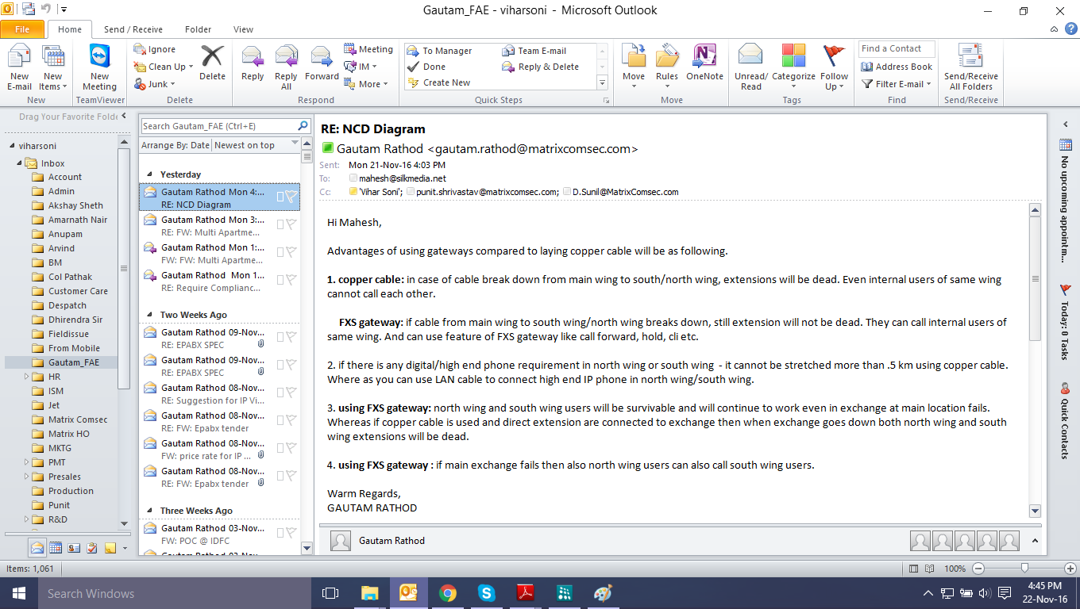
UNIFIED COMMUNICATIONS
VARTA WIN200 – Presence Sharing from Outlook Screens

Slide 20
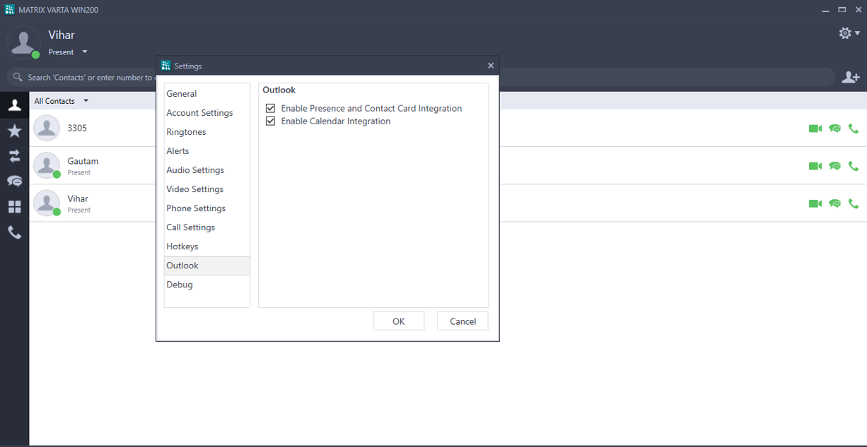
UNIFIED COMMUNICATIONS
VARTA WIN200 – Calendar Integration

Slide 21
UNIFIED COMMUNICATIONS
VARTA WIN200 – System Requirements
Supported Platforms – Matrix ETERNITY NE, PE, GENX, MENX and LENX Range of IP-PBXs
Software Version – ETERNITY V12R5.2 Onwards and Variants of SARVAM UCS
Operating System – Windows 7 Service Pack 1 and Higher
Operating System Type: 32-bit or 64-bit
Processor: CPU @ 2.0 GHz or Higher
RAM: 2GB or Higher
Hard Disk: 400MB or Higher

