Slide 1
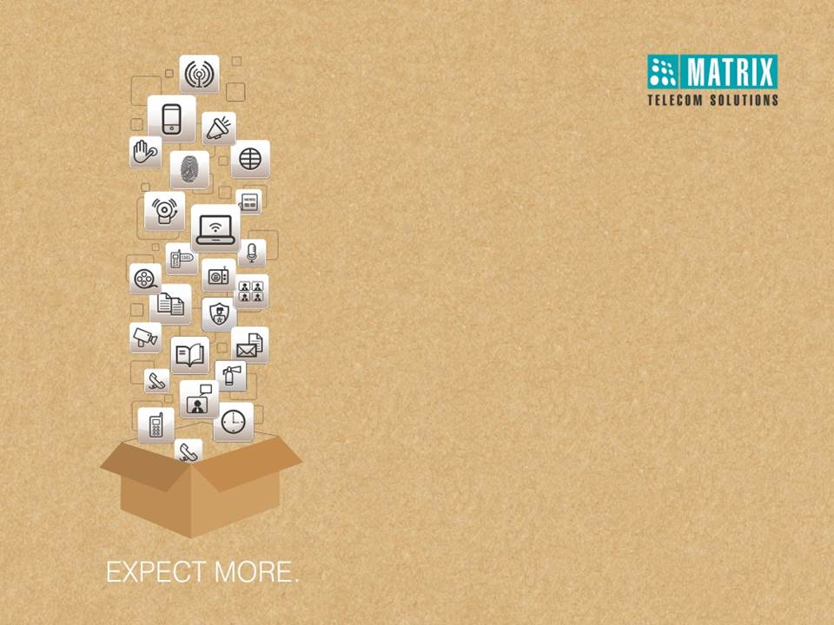
Warm Welcome
Matrix SETU VFX
Multi-port VoIP-FXO-FXS Gateways

Slide 2
SETU VFX
Presentation Overview
Introduction
Interfaces
Variants
Target Customers
Applications
Key Features

Slide 3
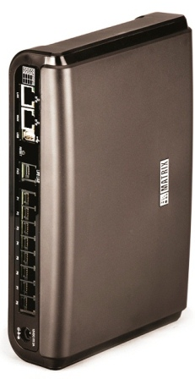
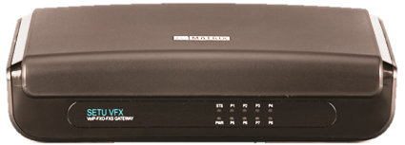
Introduction
SETU VFX
Multiport VoIP-FXO-FXS Gateway
SETU VFX links VoIP networks to traditional telephony and vice-versa
It can be interfaced with PBX or GSM FCTs having FXO Port
Eliminates the need to upgrade an existing PBX for making IP calls

Slide 4
Multi-port VoIP-FXO-FXS Gateway
Interfaces
LAN Port
WAN Port
Lifeline (FXO) Port
Phone (FXS) Ports
DC Input Jack

Slide 5
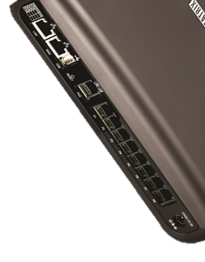
Multi-port VoIP-FXO-FXS Gateway
Product Variants
VoIP
FXS
FXO
SETU VFX880
8 VoIP Channels
8 FXO
SETU VFX808
8 VoIP Channels
8 FXS
SETU VFX 404
4 VoIP Channels
4 FXS
SETU VFX 440
4 VoIP Channels
4 FXO

Slide 6




Target Customers
Corporate Branch Offices
Organizations with Field Staff
Remote Project Sites
Call Centers

Slide 7
Applications

Slide 8





Stand-alone Application
Built-in PBX Functionality
Internet
MODEM/ROUTER
User
User
SETU VFX
PSTN
SIP Proxy

Slide 9



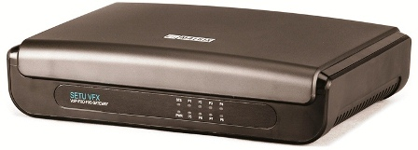
VoIP Gateway for Legacy TDM-PBX
Use legacy TDM infrastructure to make cost effective VoIP calls
Maintain existing dialing habits
Increase network connectivity options
PSTN
VoIP
Users
TDM-PBX
SETU VFX
Using services of Sify, Skype etc.
London Office
Customers

Slide 10


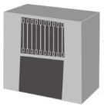

VoIP Gateway for IP-PBX
Access PSTN from VoIP infrastructure
Maintain existing dialing habits
Deployable with any SIP based IP-PBX, Softswitches and Hosted Services
Internet
PSTN
Users
IP-PBX
SETU VFX
London Office

Slide 11




Peer-to-Peer Calls
Connect remote branch offices over VoIP
Make free VoIP calls between branch offices
Increase workforce collaboration
User dials called Party
Internet
SETU VFX
SETU VFX
Calling Party
Called Party
TDM-PBX
TDM-PBX
Sydney Branch Office
Chile Branch Office

Slide 12








Multi-Site Connectivity
Interconnecting multiple sites
Head office using IP-PBX
IP-PBX
Head Office in US
(with any existing IP-PBX)
Internet
Factory office using TDM-PBX with SETU VFX
Branch office using SETU VFX
TDM-PBX
SETU VFX
SETU VFX
Branch Office in India
(without any existing PBX setup)
Manufacturing Unit in China
(with existing Traditional PBX)

Slide 13
Key Features

Slide 14


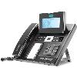
Auto PSTN Fallback
Continuous network connectivity
Reduces dependency on a single network
More reliable communication
PSTN
Call automatically gets placed through PSTN
User dials Called Party Number
IP gets down
Called Party
User
SETU VFX
VoIP

Slide 15


Automatic Number Translation
Translates complete number or a part of a dialed number to match with the numbering plan of the destination network
Automatic Number Translation (ANT) is supported on SIP
    User dials 001-xxxx to reach a number in USA, but as the ITSP understands 1-xxxx, so, ANT replaces the number 001-xxxx with 1-xxxx to let the ITSP understand the dialed number string
SETU VFX replaces 001-3018432834
with 1-3018432834
before Dialing out
VoIP
User dials
001- 3018432834
SETU VFX

Slide 16
Call Progress Tones and Rings
Different Tones can be configured to indicate the progress of a Call Activity
      Dial Tone, Ring Back Tone, Busy Tone, Error Tone, Feature Tone and Confirmation Tone
Tones with different cadence, with specific frequency are offered
User can select a desired tone which matches with the tones used in the concerned region

Slide 17
Caller Line Identification and Presentation
Caller ID Types - DTMF Detection, FSK ITU-T and FSK Bellcore
Caller line presentation for external and internal numbers
FXS Port can be configured for CLIP protocol as per use

Slide 18
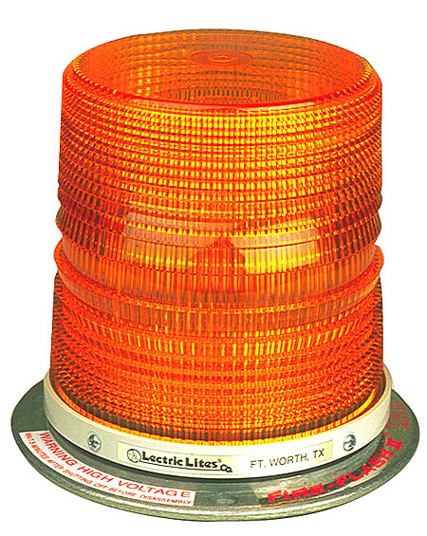
Emergency Number Dialing
SETU VFX Supports a pass-through port for dialing emergency numbers
About feature
    Acts as a redundancy line in case of internet/power failure
    Can be connected to PSTN/GSM FCT for making calls
    It is meant for INCOMING calls only

Slide 19




Group Call Pickup
Flexibility to answer a call from any extension
Save time and effort to pick a call
Increase call response rate
Not available on desk
Called Party
User dials
Called Party
SETU VFX
Other member in the group Picks above call
Group Member

Slide 20
Life line Support
Maintain business continuity even in power failure
Reliable network connectivity
Increase productivity
Power Gets Down
Internet
User
SETU VFX
Calls Automatically get routed through PSTN
PSTN

Slide 21





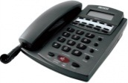
Message Wait Indication
Quick and easy retrieval of voice messages
Voice message indication by:
  Message wait LED indication on phone
  Change in dial tone (shuttered dial tone)
  Voice message before dial tone
Message wait tone
Voice message indicator blinks
Incoming call
SETU VFX
ITSP/PBX User Voice mail box

Slide 22


SIP Security over TLS/SRTP
Communicate securely over VoIP
Share business secrets with partners over VoIP without worrying for security
Place important calls using VoIP
Internet
User
SETU VFX
Secured SRTP/TLS connection
SETU VFX
User
Argentina Office
Poland Office

Slide 23
TR-069 Auto-Configuration
TR-069 is a Secure Remote Management Protocol
It is used for Auto-configuration and Remote management of the device at customer premises from an Auto-Configuration Server
It supports a variety of functionalities:
Dynamic Service Provisioning
Firmware Management
Status and Performance Monitoring
Remote Diagnostics

Slide 24
Feature List
Allowed and Denied Numbers
TR-069 Auto-Configuration
Auto PSTN Fallback
Auto Provisioning
Automatic Number Translation
Call Detail Records (CDR)
Call Duration Control
Call Progress Tone and Rings
Direct Dial-In (DDI) Routing
Dynamic DNS
Digest Authentication
Emergency Number Dialing
DHCP Server and Client
Hotline
Message Wait Indication
NAT and STUN
Port Forwarding and DMZ
Programmable Call Progress Tones
PSTN Life Line Support
Peer-to-Peer Calling
PIN Authentication
Return Call to Original Caller (RCOC)
SIP Security over TLS/SRTP
SNMP Monitoring
Web based Management

Slide 25
Matrix GATEWAY RANGE OF PRODUCTS
PRODUCT | DESCRIPTION
SETU ATA | VoIP Adaptor with GSM, FXO and FXS Ports
SETU VGFX | Multi-port SIP based VoIP to GSM/3G-FXO-FXS Gateway
SETU VGB | Multi-port SIP based VoIP to ISDN BRI Gateway
SETU VTEP | SIP based VoIP to T1/E1 PRI Gateway
SETU VFXTH | Medium-Density Multi-port SIP based VoIP to FXO-FXS Gateway
SIMADO GFX | Multi-port GSM to FXS Gateway
SIMADO GBR | Multi-port GSM to BRI Gateway

Slide 26

Notes:
26

Slide 27
Type of Presentation: Product Presentation
Number of Slides: 27
Revised On: 1st Dec 2014
Version-Release Number: V2R1
For Further Information Please Contact:
Email ID: More@MatrixComSec.com
Visit us at www.MatrixTeleSol.com

