Slide 1
Unified Communication Server for Modern Enterprises

Slide 2
SARVAM UCS
Unified Communication Server for Modern Enterprises

Slide 3
UNIFIED NETWORKS
COLLABORATION
UYOD
SARVAM UCS
UNIFIED MESSAGING
MOBILITY

Slide 4
MOBILITY - Application for Android and iOS Smartphones - Application for Windows PC - One Number Reach
UNIFIED NETWORKS - VOIP (SIP)
- GSM/3G (Voice/SMS)
- ISDN T1E1 PRI
- PSTN/CO/FXO
UYOD
- Android Smartphone/Tablet
- iOS Smartphone/Tablet
- Windows PC
- SIP Video Phone
- SIP Phone
- Analog Phone
UNIFIED NETWORKS
SARVAM UCS
UNIFIED MESSAGING
- SMS to Email
- Email to SMS
- Voice Mail to Email
- SMS over GSM SIMs
COLLABORATION - Presence and Chat
- Audio Conferencing
- Video Calling
- Corporate Directory Integration
- Voice Mail System

Slide 5
KEY DIFFERENTIATORS
Presence
IM / Chat
Unified Messaging
Conferencing
Voice / Video
Calling
Collaboration
Client – VARTA WIN200
Mobile
Client – VARTA ADR/IOS100
Application
Integration

Slide 6
TRAGET CUSTOMERS
Modern Enterprises
Star Hotels
Specialty Hospitals
SIP Trunking Service Providers

Slide 7
SOLUTION OVERVIEW
TELEPHONY | 99 SIP Trunks | 8 T1E1 ISDN PRI | 40 GSM SIMs | 128 POTS (CO)
ENDPOINTS | 999 UC CLIENTS | 999 IP SUBSCRIBER | 96 Key Phones | 240 Analog Phones
APPLICATIONS | Android/iOS/Windows PC UC Client | Voice Mail | SMS Gateway SMS to Email Email to SMS | Hospitality Module
INTEROP | ITSPs (VOIP Carriers) | PMS/CAS Integration | Third-Party SIP Devices | Call Center Solutions
MANAGEMENT | Web based GUI | Remote Support | SNMP | Class of Services

Slide 8
SARVAM UCS ARCHITECTURE
ETERNITY
GENX12S
Platform
SARVAM UCS SME
Server
SARVAM UCS SME
Server

Slide 9
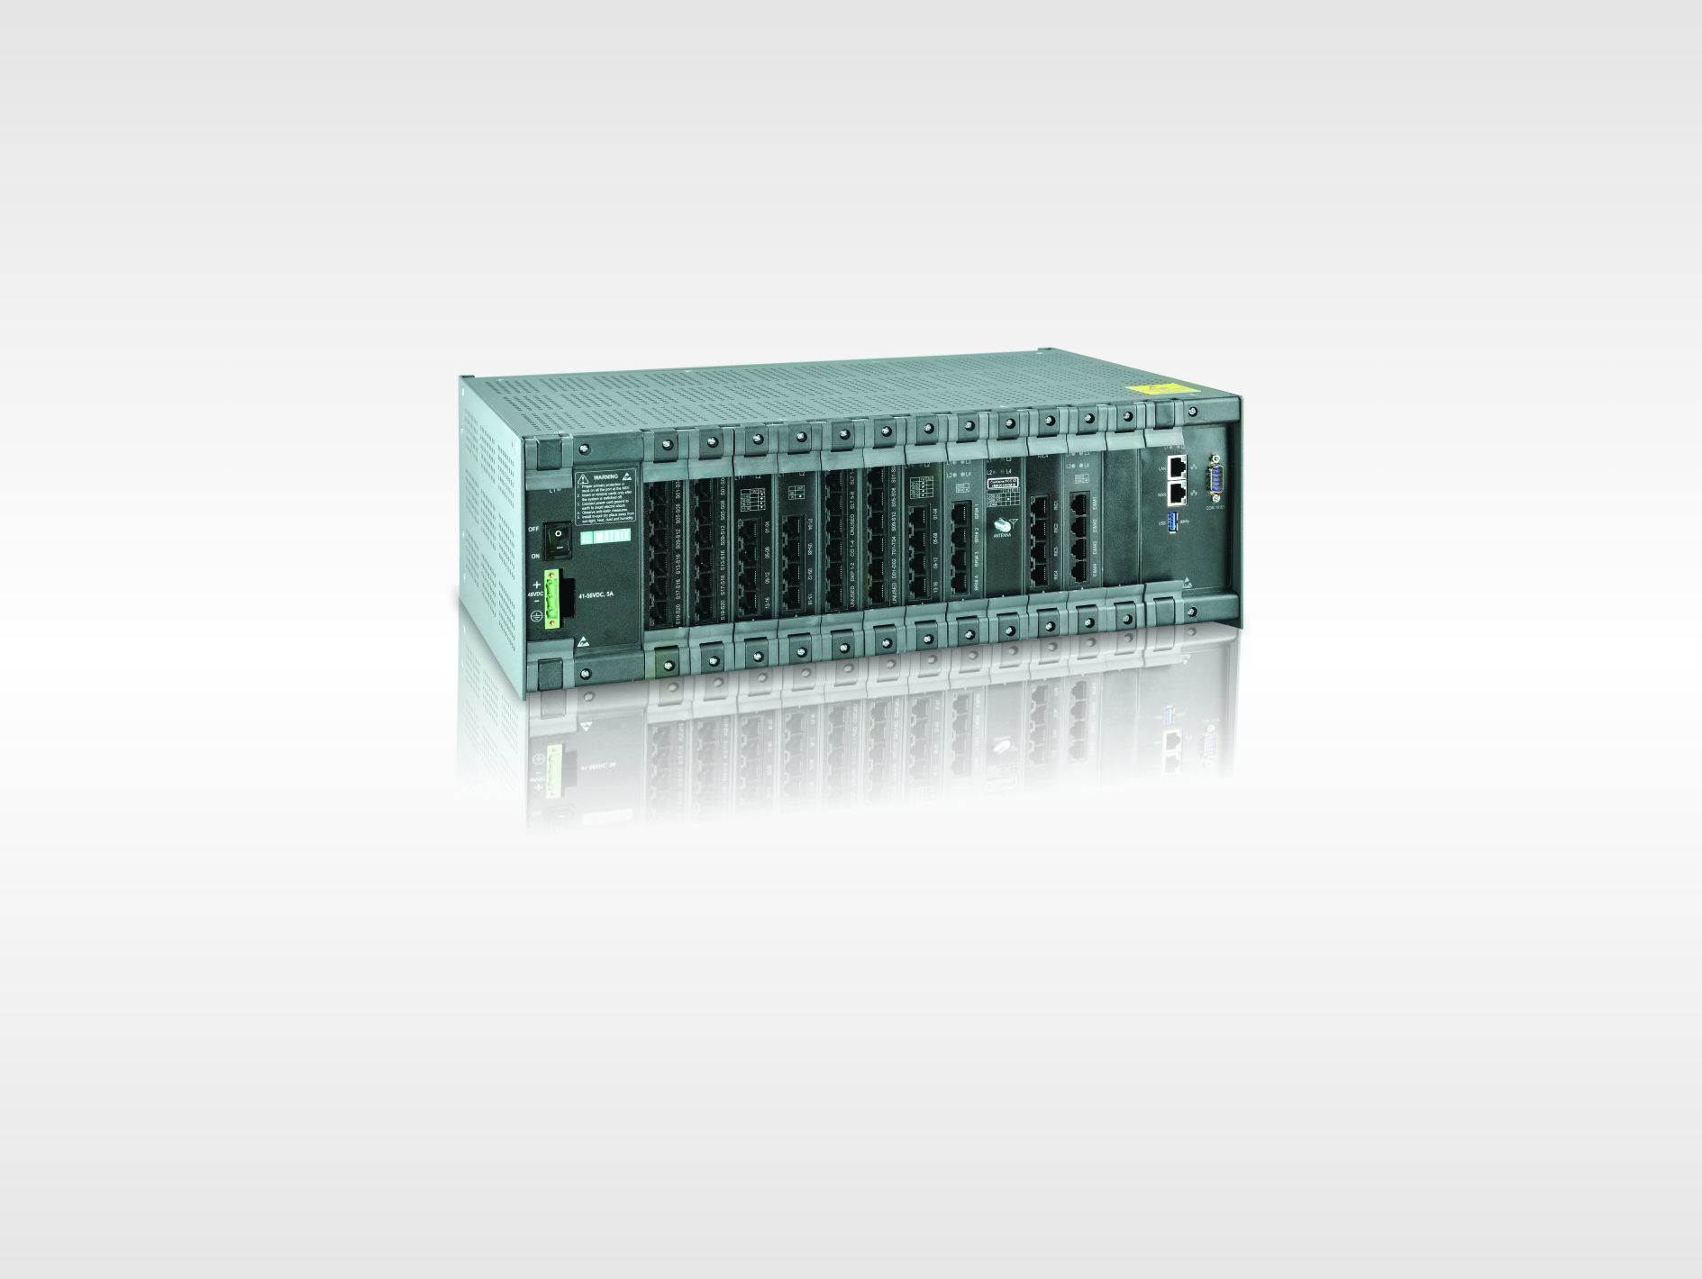
ETERNITY GENX12S Platform
250W AC/DC PS + 12 Universal Slots + CPU
On-board VOIP and VMS Provision
Optional – DAUGHTER BOARD MODULE for VOCODER and VMS Channels on CPU
Gigabit LAN and WAN
IPv6 Ready
19” Rack Mountable 4U Enclosure
Interface Cards support of ETERNITY GE

Slide 10
SARVAM UCS SME Server
Max. SIP Trunks | Max. VOCODER Channels (Module) | Max. IP/UC Users | Max. TDM Ports | Max. VMS Channels (Module)
99 | 128 (2) | 999 | 240 | 64 (1)
Server software for ETERNITY GENX
VOCODER CHNL – for simultaneous calls with transcoding
VMS CHNL – for simultaneous voice mail sessions
IPSUB – create VOIP Subscribers
VARTA USER E – UCS Soft clients with essential features
VARTA USER P – UCS Soft clients with professional features

Slide 11
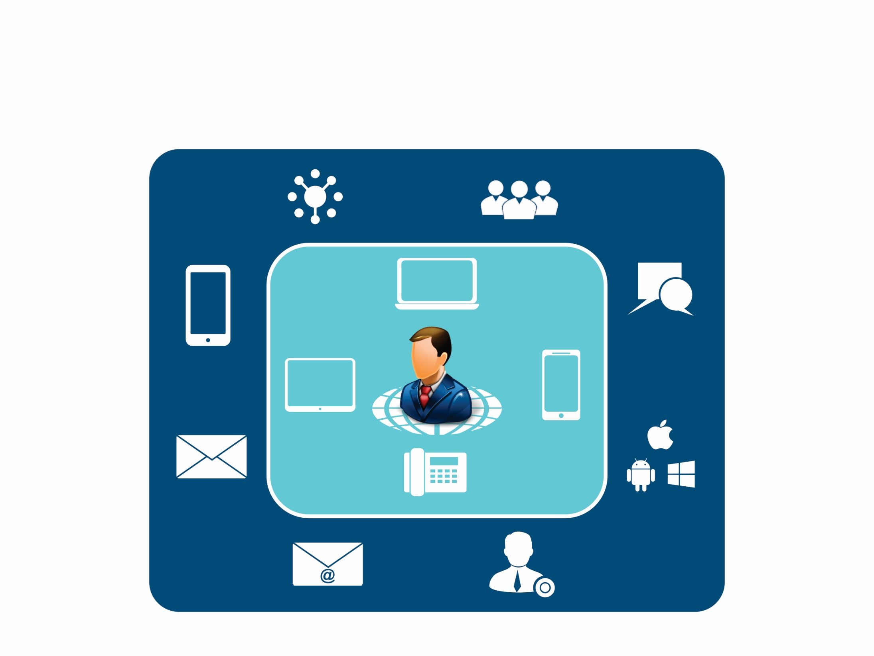
SARVAM UC Solution
Unified
Networks
Conference
PC
Smartphone
Chat
Mobility
Tablet
IP Phone
Unified Messaging
Unified Clients
Email to SMS
Presence

Slide 12
MOBILITY

Slide 13
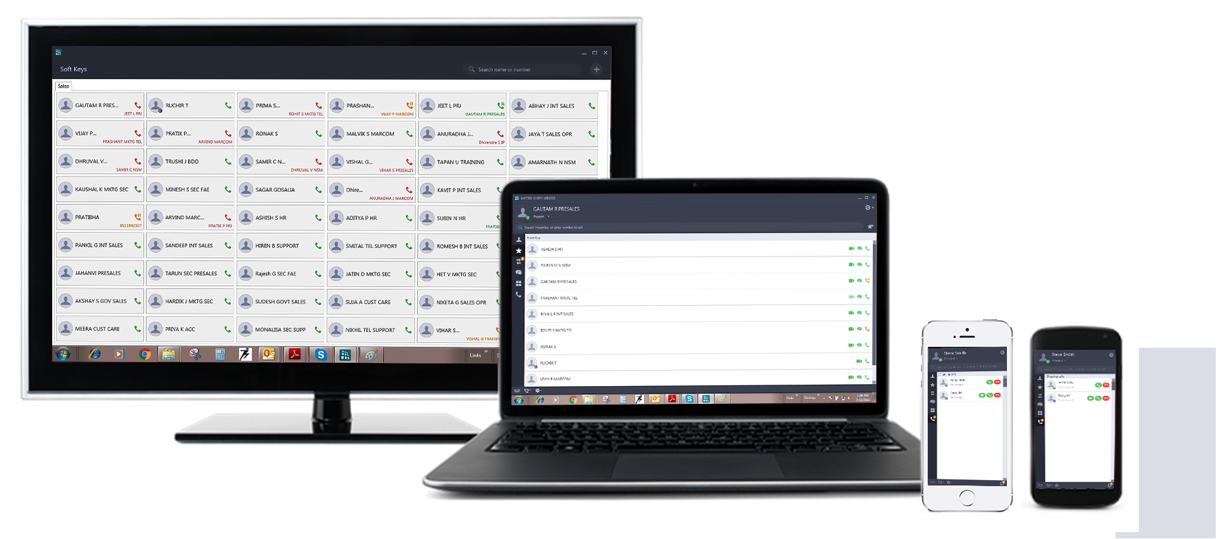
Use Your Own Device (UYOD)

Slide 14
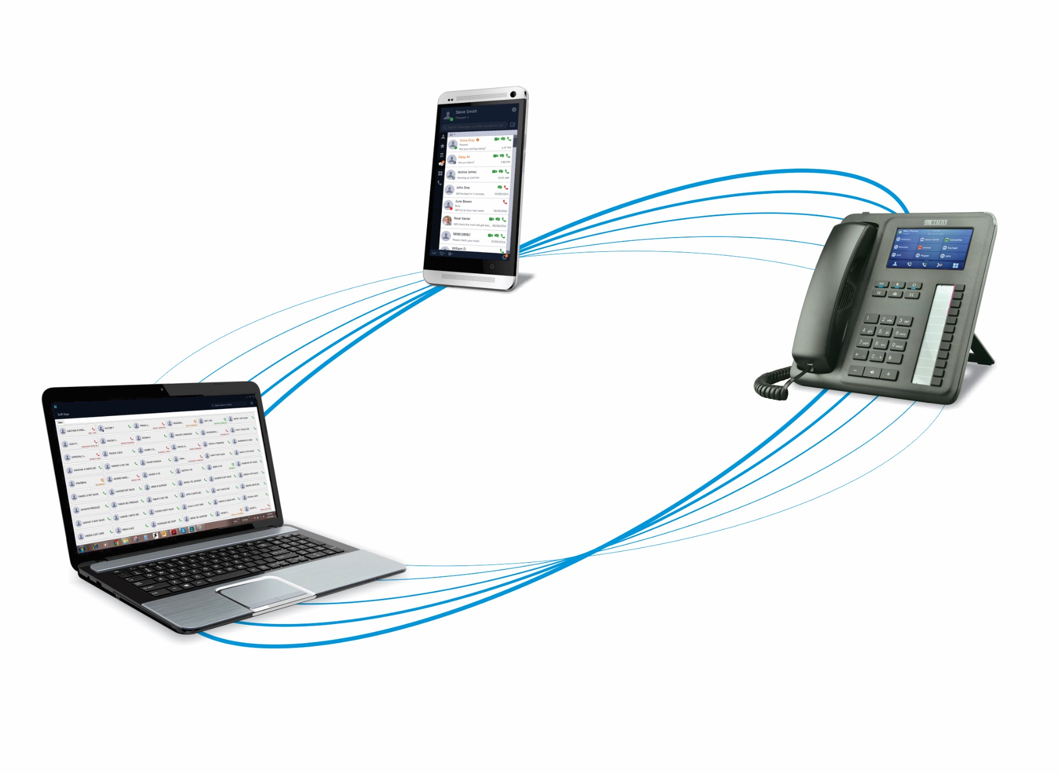
Multiple Devices One Number Reach

Slide 15
UNIFIED NETWORKS

Slide 16
SIP TRUNKING
MOBILE VOICE
GSM
ISDN BRI
ISDN T1/E1 PRI
FIXED TELEPHONY
E&M
RADIO

Slide 17
UNIFIED CLIENTS

Slide 18
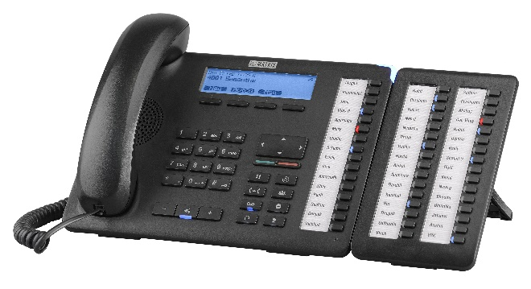
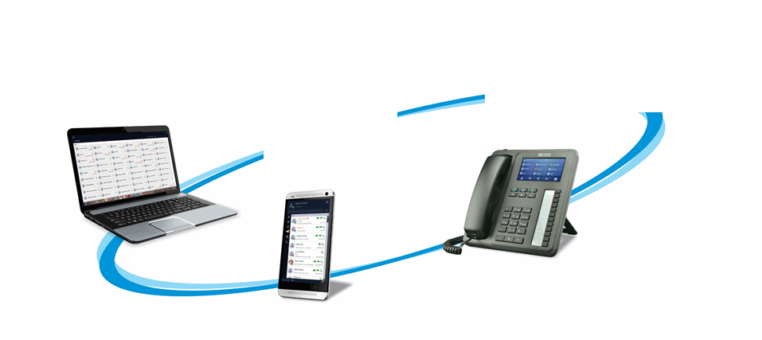
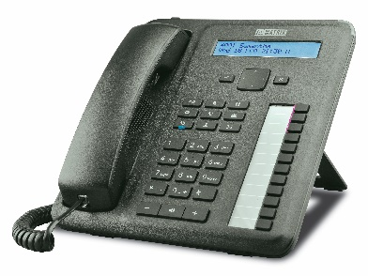
Future Ready Connect to New-age UC Clients

Slide 19
UNIFIED MESSAGING

Slide 20
Unified Messaging
PRESENCE &
CHAT
CONFERENCING
EMAIL TO
SMS
TELEPHONY
FEATURES
VOICEMAIL TO
EMAIL

Slide 21
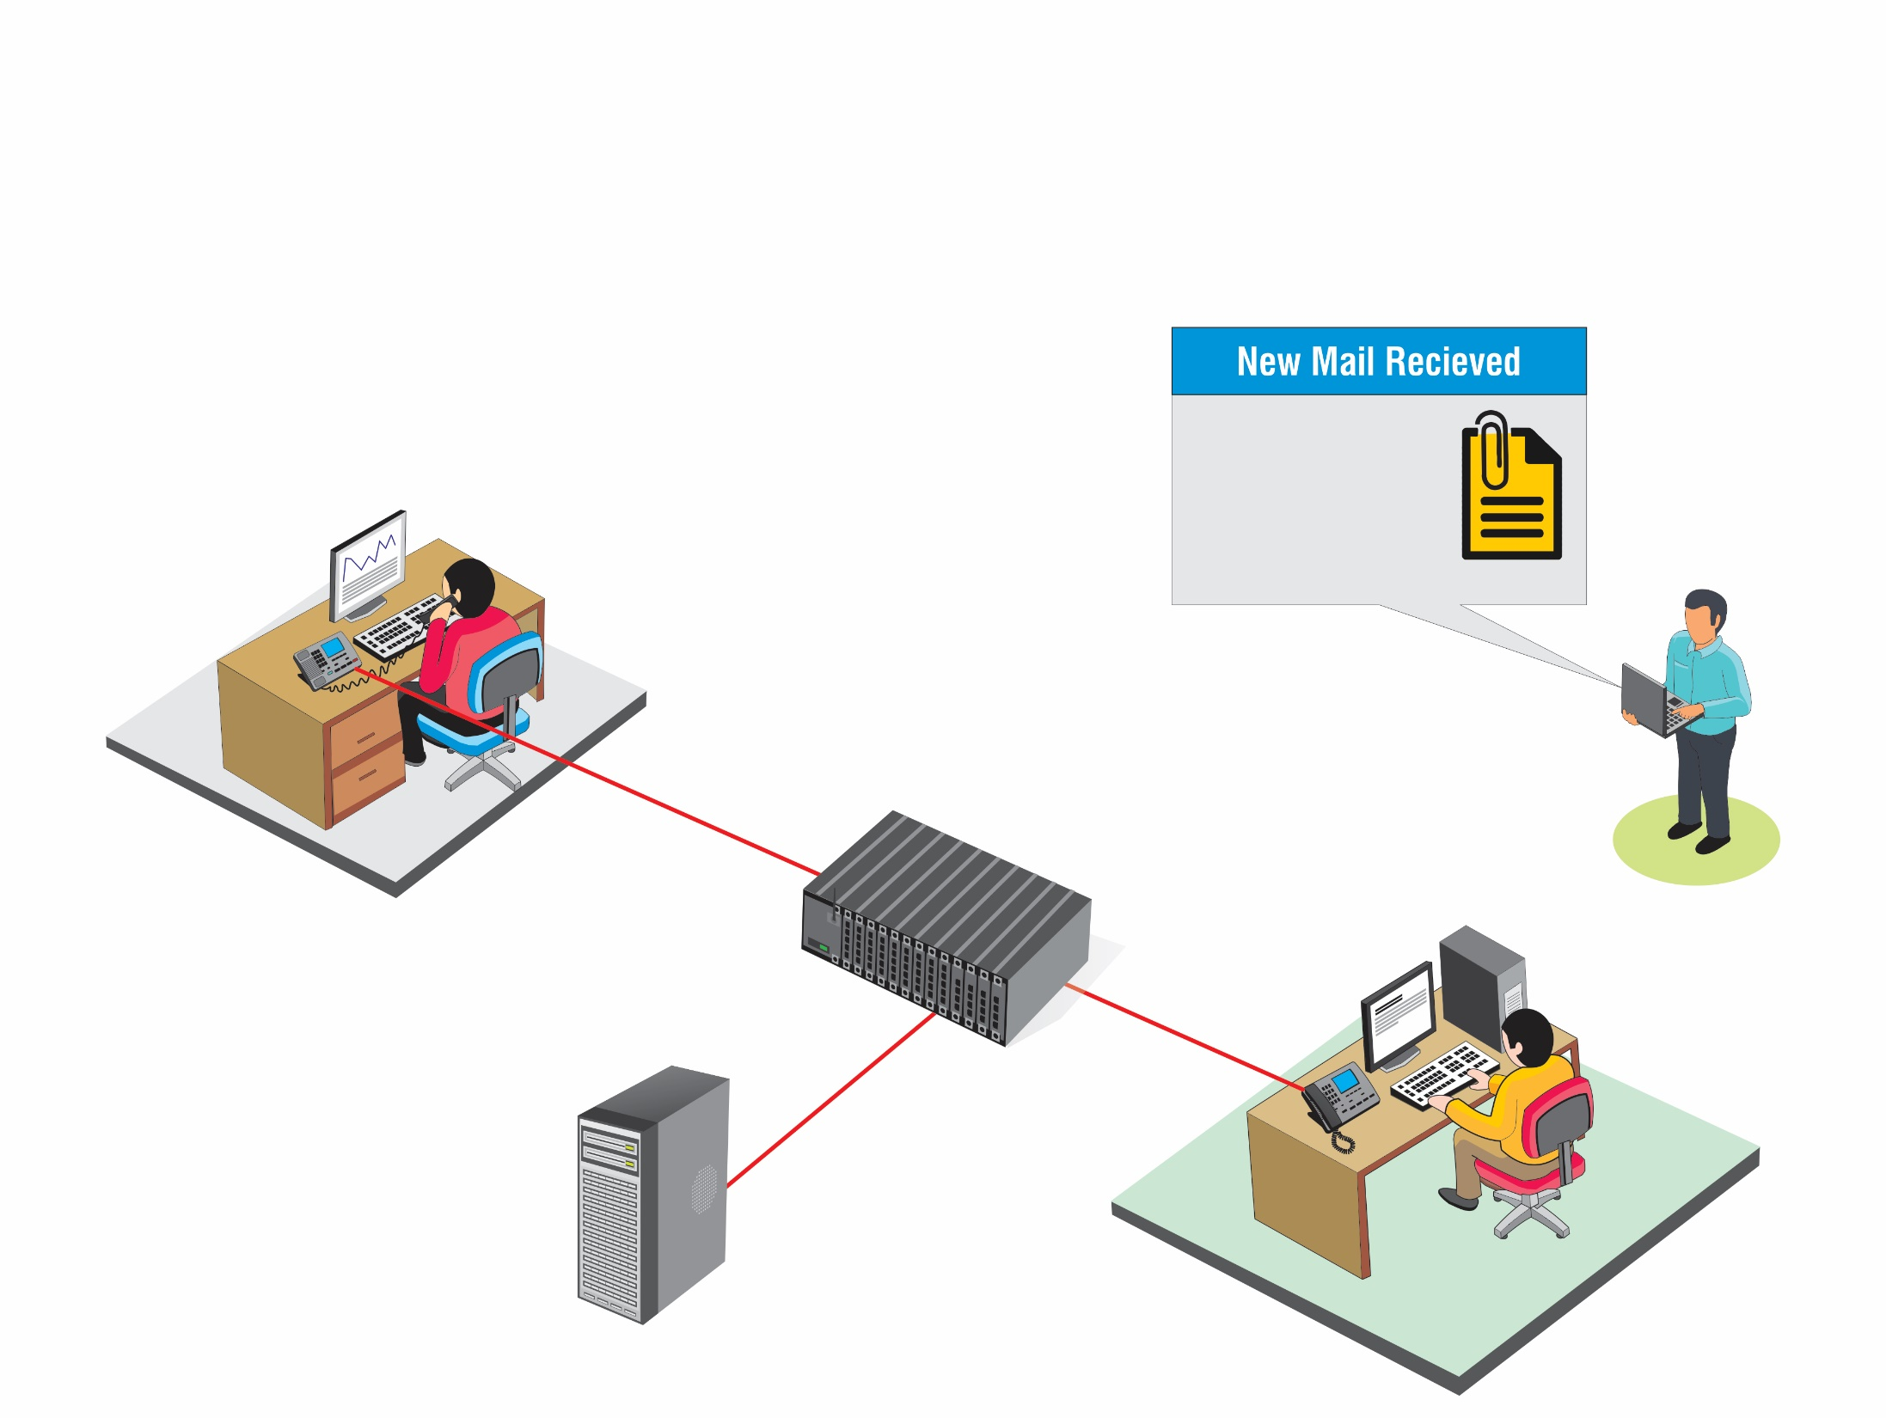
VOICEMAIL TO EMAIL
New message in Mailbox received on 5th May, 16 at 2:00PM
Message: XXX.wav
MATRIX ETERNITY
john@abc.com
BRANCH OFFICE
Calling JOHN. Ext 501
SMTP Client
Ext 501
JOHN
MAIL SERVER
HEAD OFFICE

Slide 22
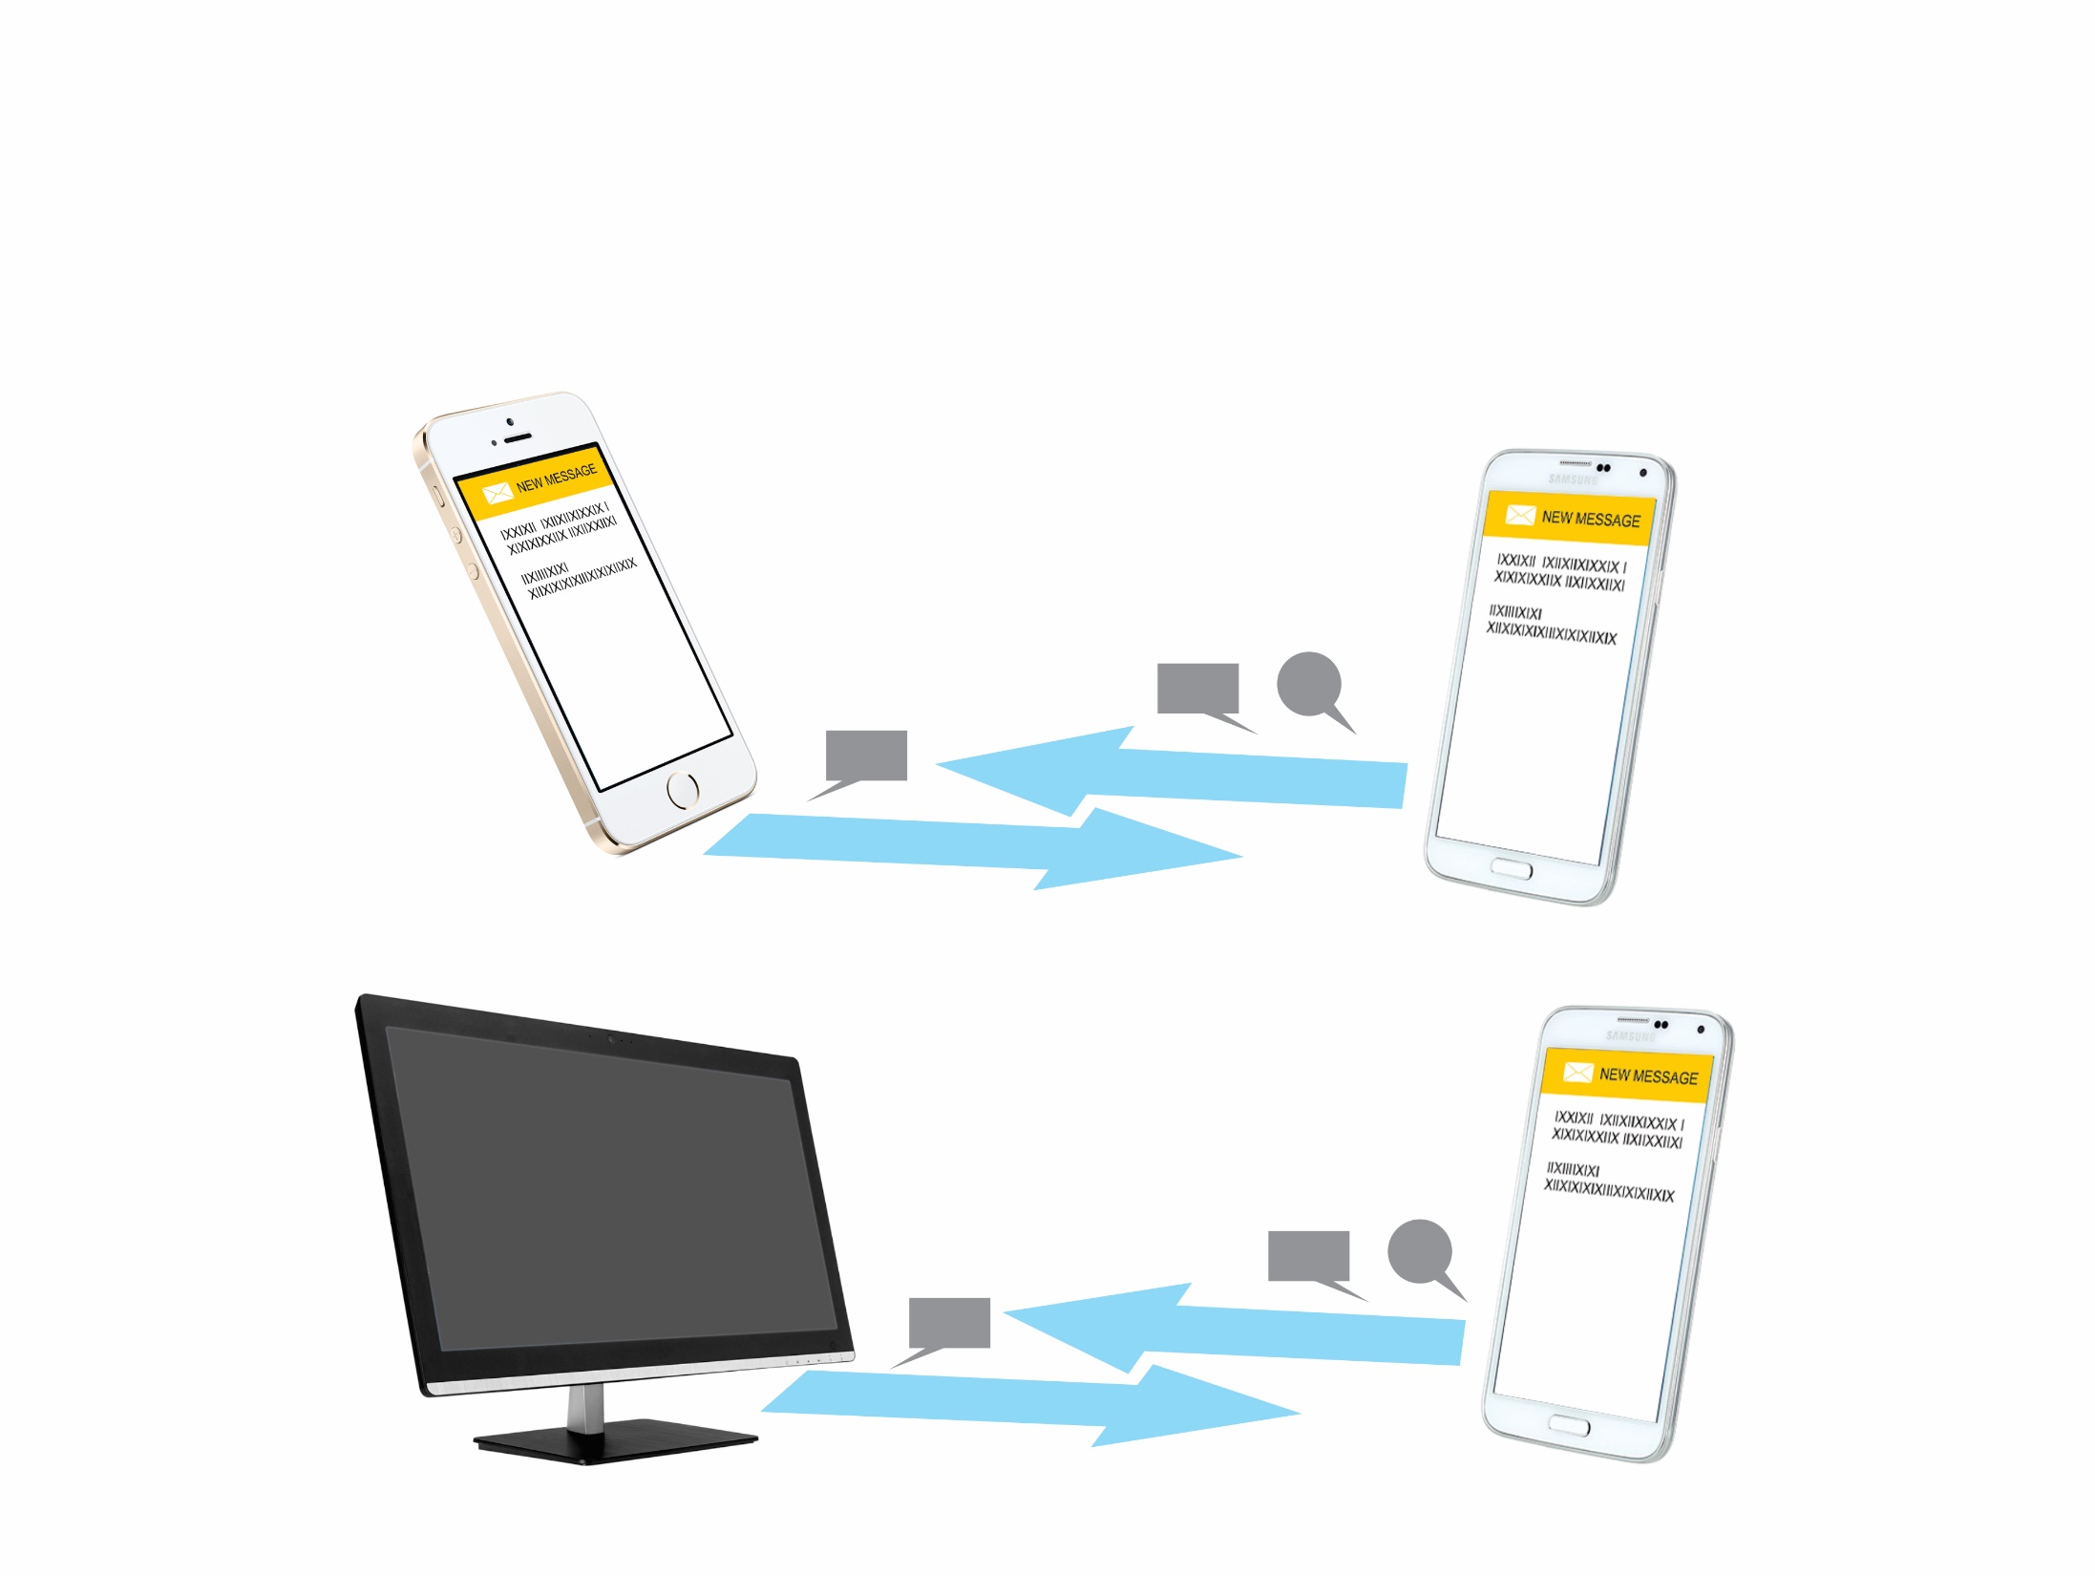
PRESENCE AND CHAT

Slide 23
TELEPHONY FEATURES
Global Directory Integration
Comprehensive Call Handling
Drag and Drop Conference
One Touch Access

Slide 24
CONFERENCING
62 Participants Audio Conference
Crystal Clear Voice
External and Internal Participant
Multiple Conference Group
3-Party Conference of 20 Groups
21-Participants in Single Conference
Conference Dial-in

Slide 25
Next-Generation Platform
Technical Specifications
TECHNICAL PARTICULARS | ETERNITY GENX | ETERNITY MENX# | ETERNITY LENX#
Compatible Server Software | SARVAM UCS SME | SARVAM UCS ENT | SARVAM UCS ENT
VOIP (SIP) Trunks | 99 | 99 | 99
GSM/3G Trunks | Up to 40 | Up to 64 | Up to 64
CO Ports | Up to 64 | Up to 128 | Up to 128
VOIP (VOCODER) Channels | Up to 128 | Up to 256 | Up to 256
ISDN T1/E1 PRI Channels | Up to 240 Ch. (8 Ports) | Up to 240 Ch. (8 Ports) | Up to 1200 Ch. (24 Ports)
ISDN BRI Channels | Up to 64 Ch. (32 Ports) | Up to 64 Ch. (32 Ports) | Up to 64 Ch. (32 Ports)
# Launching in September-2016

Slide 26
Next-Generation Platform
Technical Specifications
TECHNICAL PARTICULARS | ETERNITY GENX | ETERNITY MENX# | ETERNITY LENX#
IP Subscribers | Up to 999 | Up to 2000 | Up to 2000
Digital Subscribers | Up to 96 | Up to 128 | Up to 128
Analog Subscribers | Up to 240 | Up to 288 | Up to 1296
Voice Mail Channels | Up to 64 | Up to 64 | Up to 64
Power Supply | 100-240 VAC, 47-60Hz 48VDC +20% to -15% | 100-240 VAC, 47-60Hz 48VDC +20% to -15% | 48VDC +20% to -15%
Redundancy | No | Yes (AC and DC Power Supply and CPU Card) | Yes (DC Power Supply and CPU Card)
Hot-Swap | No | Yes | Yes
Installation | 19” Rack Mount with 4U Enclosure Wall Mount Table Top | 19” Rack Mount Wall Mount Table Top | 19” Rack Mount Wall Mount Table Top
# Launching in September-2016

Slide 27
Next-Generation Platform
Technical Specifications
SYSTEM RESOURCE | MAXIMUM RESOURCES (ETERNITY GENX) | DESCRIPTION
IP USERS/UC Clients | 999 | Scalability of SARVAM UCS SME
NX DBM VOCODER64 | 2 Modules (128 Channels) | VOCODER DAUGHTER-BOARD MODULE (HARDWARE) for ETERNITY GENX/MENX/LENX CPU cards capable to support maximum 64 simultaneous VOCODING channels
NX DBM VMS64 | 1 Module (64 Channels) | Voice mail DAUGHTER-BOARD MODULE (hardware) having capability to support maximum 64 simultaneous voice mail sessions for ETERNITY GENX/MENX/LENX CPU card
Concurrent IP to IP Calls WITHOUT Transcoding | 550 | SARVAM is built-on with IP at core
Concurrent IP to IP Calls WITH Transcoding | 64 | One VOCODER channel is used to transcode every call using transcoding

Slide 28
Next-Generation Platform
Technical Specifications
SYSTEM RESOURCE | MAXIMUM RESOURCES (ETERNITY GENX) | DESCRIPTION
Concurrent IP to TDM Calls | 128 | One VOCODER channel is used to transcode every IP to TDM call.
Concurrent Video Calls from IP User to other IP User | 55 | VOCODER Channel is not used (Does not support transcoded video calls)
Concurrent Audio Conferences (3-Participants) | 20 | SARVAM does not need any special license for conferencing. It allows maximum 62 participants in conferences.
Participants in a Single Audio Conference | 21 | SARVAM does not need any special license for multi-party conferencing.
Concurrent Voice Module (Play Voice Messages) | 9 | Concurrent calls management with Auto-attendant
Features need transcoding channel (NX DBM - VOCODER Channels) | Conference - for each IP call, Conversation Recording/Call Tapping - for each IP Call, Retrieval of Voice Mail - from each IP user, Trunk auto-answer/VMS Auto-attendant – for each incoming call on SIP Trunk, for each IP to non-IP call

Slide 29
ORDERING INFORMATION
PRODUCT | DESCRIPTION
SARVAM UCS SME | Matrix SARVAM Unified Communication Server for SME for ETERNITY GENX (hardware). Preloaded with licenses for 5 IPSUB, 4 VOCODER CHANNELS and 4 VOICE MAIL CHANNELS. For VOCODER and VOICE MAIL, respective daughter-boards are required
SARVAM VOCODER CHNL4 SARVAM VOCODER CHNL16 | VOCODER CHANNELS for SARVAM UCS to support 4/16 simultaneous calls with transcoding
SARVAM VMS CHNL4 SARVAM VMS CHNL16 | License for VOICE MAIL CHANNELS for SARVAM UCS to support 4/16 simultaneous voice mail sessions
SARVAM IPSUB5 SARVAM IPSUB10 SARVAM IPSUB50 SARVAM IPSUB100 SARVAM IPSUB500 | License of IP Subscribers for SARVAM UCS to create 5/10/50/100/500 VOIP subscribers.
SARVAM VARTA USER5E SARVAM VARTA USER10E SARVAM VARTA USER50E SARVAM VARTA USER100E SARVAM VARTA USER500E | License for 5/10/50/100/500 VARTA UCS SOFT CLIENTS with ESSENTIAL features. SARVAM UCS needs this license to register ANDROID/IOS/WINDOWS DESKTOP UCS CLIENTS. This licensee is not required for HARDWARE IP-PHONES

Slide 30
ORDERING INFORMATION
PRODUCT | DESCRIPTION
SARVAM VARTA USER5P SARVAM VARTA USER10P SARVAM VARTA USER50P SARVAM VARTA USER100P SARVAM VARTA USER500P | License for 5/10/50/100/500 VARTA UCS SOFT CLIENTS with PROFESSIONAL features. SARVAM UCS needs this license to register ANDROID/IOS/WINDOWS DESKTOP UCS CLIENTS. This licensee is not required for HARDWARE IP-PHONES
NX DBM VOCODER64 | VOCODER DAUGHTER-BOARD MODULE (hardware) for ETERNITY GENX/MENX/LENX CPU CARDS capable to support maximum 64 simultaneous VOCODING CHANNELS. UCS AND UMG SERVER licenses are supplied with 4 built-in VOCODER CHANNELS. Additional VOCODER CHNL license is required to activate desired number of channels
NX DBM VMS64 | VOICE MAIL DAUGHTER-BOARD MODULE (hardware) having capability to support maximum 64 simultaneous VOICE MAIL SESSIONS for ETERNITY GENX/MENX/LENX CPU CARD. Separate VMS CHANNEL license is required to activate desired number of channels

Slide 31
ORDERING INFORMATION
PRODUCT | DESCRIPTION
ETERNITY GENX12SAC* | ETERNITY GE NEXT-GENERATION PLATFORM with CPU CARD, 12 UNIVERSAL SLOTS and AC power supply in 19INCH 4U ENCLOSURE. VOCODER and VOICE MAIL HARDWARE DAUGHTER-BOARD MODULES are NOT INCLUDED
ETERNITY GENX12SDC* | ETERNITY GE NEXT-GENERATION PLATFORM with CPU CARD, 12 UNIVERSAL SLOTS and DC power supply in 19INCH 4U ENCLOSURE. VOCODER and VOICE MAIL HARDWARE DAUGHTER-BOARD MODULES are NOT INCLUDED
* Please refer Next-generation Specification DATASHEET for detailed Technical Specifications

Slide 32
THANK YOU

Slide 33
For further information please contact: Ruchir.Talati@MatrixComSec.com +919662544402

