Slide 1
Matrix Hospitality Solution
Customer Service made Simple

Slide 2
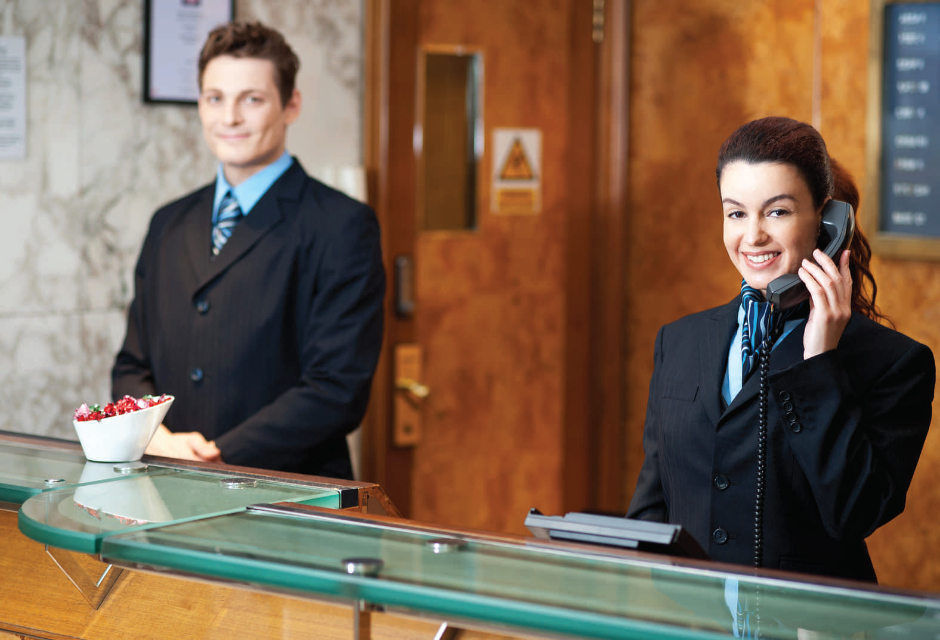
Matrix Hospitality Solution

Slide 3
Agenda
What are the Needs of Hotel?
Why you need Matrix to explore this Opportunity?
Matrix – A leading Hospitality Solution Provider
A Product Mix to meet every need of Hotels
Matrix Advantages
What Matrix has for Hotels
Hotel Phone System
Comprehensive Set of Hotel Features
Range of Intuitive hotel phone extensions

Slide 4
What Hotels are looking for?
Guest Services
Staff
Optimize the Service Offering and Deliver Anytime Services
Improve Staff Efficiency & Productivity
Matrix Hospitality Solution
Create more Revenue Generation Opportunities
Control Costs
Revenue
Costs
Enhance Customer Satisfaction | Increase Staff Efficiency
Increase Revenue from each walk-out Customer | Increase Staff Responsiveness to Customers
Reduce Overheads | Reduce Operational Costs

Slide 5
Why select Matrix Hospitality Solution
Established brand for Hotel Communication Systems
Valued solution for Smaller to Medium size hotels
Trusted by many Leading Hotels and Hotel chains in more than 30 countries
More than 500 satisfied hotels and hoteliers
A future proof investment for Hoteliers
Tested and Certified integration with leading PMS and CAS

Slide 6
Matrix Advantages
Single System serving Multiple Applications | Universal Personality Slots, No Fixed System Bottlenecks
Modular Configuration | Scalable Platform
Universal Connectivity (In Skin GSM, VoIP, ISDN, BRI, PRI and CO connectivity) | Similar features across Platforms (ETERNITY PE, GE, GENX, ME and LE)
Common User Terminals across Platforms | Avoid Re-Programming New System, Port Backup Configuration to New Platform
Enterprise Grade Connectivity (BRI, GSM, VoIP) and features | Compact Foot Print
Hot-Swappable Cards (ETERNITY ME and ETERNITY LE) | Redundancy (ETERNITY ME and ETERNITY LE)
Open to Third Party PMS and CAS Support | Quick Installation Wizard
Built-in Auto-Attendant | Voice Mail Support
IP Server for Advanced VoIP functionalities | Transparent Cost – No Hidden Cost
Early ROI | 24 x 7 Online Support

Slide 7
How Matrix can help you to Explore Hospitality segment

Slide 8
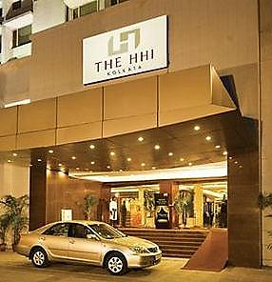
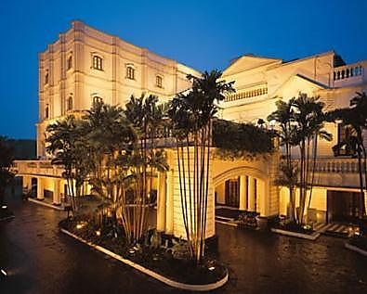
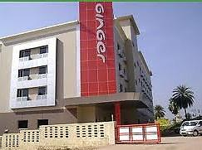
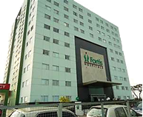
Where to sell Matrix Hotel Solution
Target Customers
Full-Services Starred Hotels
Resorts
Limited Services Hotels
Business Hotels
Guest-Houses and Inns
Motels
Hospitals
Nursing Homes
* Logos are of respective Hotel/Resort/Hospital owner

Slide 9
How Matrix helps Hotels
Operator Benefits | Hotelier Benefits
Automate routine calling activities | Boost staff efficiency and productivity
Greet every caller with automated voice prompts and reduce call load | Enhance hotel brand through automated voice greets
Enrich customer experience and services | Reduce Operating Costs
Quick and impressive services to guests | Increase guest satisfaction and loyalty
Engage service staff immediately upon the receipt of guest request | Systematic and Transparent hotel operations with any PMS application
Effective room monitoring from reception | Extend mobility to staff members through wireless phones and IP DECT
Set and Change guest preferences without going to guest room | Receive important hotel calls to Mobile phone when away from the hotel
Effective guest check-out with accurate billing | Easy integration with existing telephony interfaces

Slide 10
How Matrix helps Hotels
Guest Benefits
Set customized Reminders as per the convenience
Can be connected with office callers through Voicemail and VoIP
Cost-effective long distance calling to minimize roaming costs
Receive important guest room phones over Mobile phone while away
Receive prompt service from the service staff

Slide 11
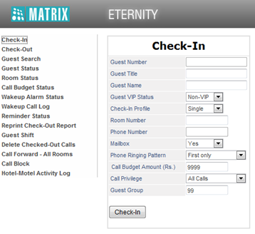
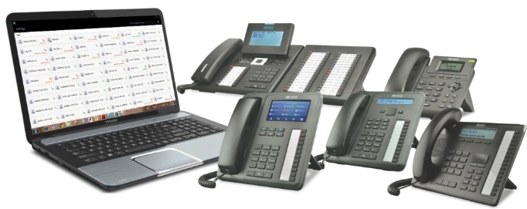
What Matrix has for Hotels
Hospitality Phone Systems
To effectively manage daily call activities
Built-in Front Desk Management Software
To effectively manage operator operations without additional software
Hotel Phones
To offer memorable experience and convenience to guests and operator

Slide 12
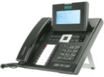
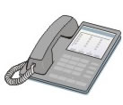
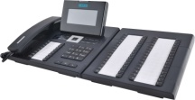
What Matrix has for Hotels
SIP
Phone
Mobile
Phone
Wireless
Phone
Guestroom Phone
Operator
Console
Voice Mail
Automated
Voice Greetings
GSM
PSTN
Flexible User Options
VoIP
Valued-added Services
for enhanced customer services
ISDN
Matrix Hospitality Solution
Multiple Trunk Options
Third-party
PMS and CAS
Web-based Configuration
Security Devices
Door Lock, Sensor, etc.
Paging and External Music devices
Easy Administration and Remote Maintenance
Easy Integration

Slide 13
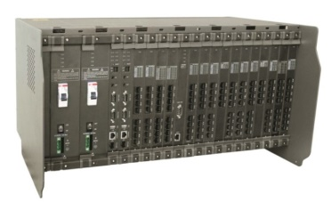
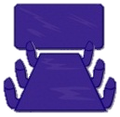
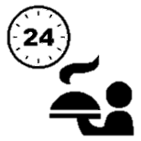
Create blend of services for hotels with IP Technology
What Matrix has for Hotels
IP
Voice
Video
Data
Reception Area
Guest
Rooms
Business Areas
Reception Area
Guest
Rooms
Business Areas
Matrix IP-PBX
Reception Area
Guest
Rooms
Cafeteria
Business Areas
Pool
Area
Service Areas
Ring Profits with Convergence

Slide 14
Hospitality Illustration
Lounge
301
302
303
Housekeeping
3rd Floor
Suite
Suite
Suite
Manager
Deluxe Double
Deluxe Double
Deluxe Double
Housekeeping
2nd Floor
201
202
203
Reception
Standard Single
Standard Single
Standard Single
Housekeeping
1st Floor
9
101
102
103
Upstairs
Hotel – The Good Life Inn

Slide 15
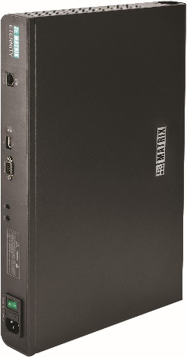
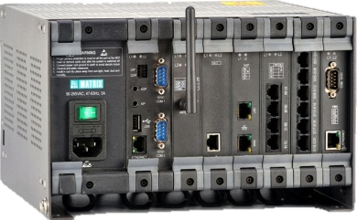
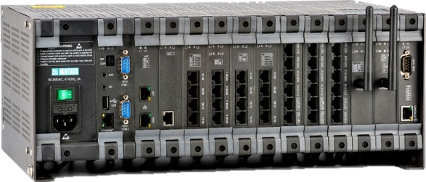
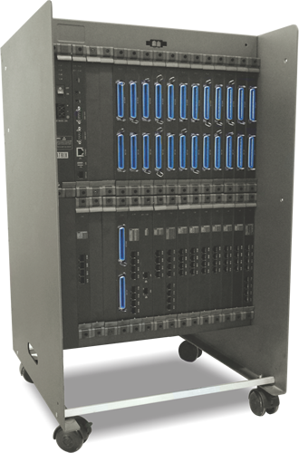
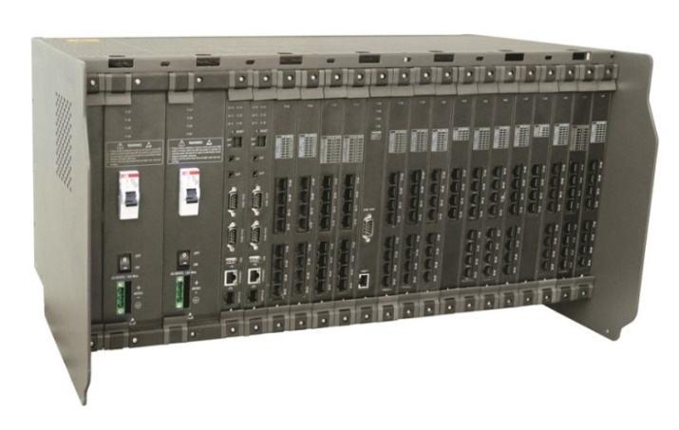
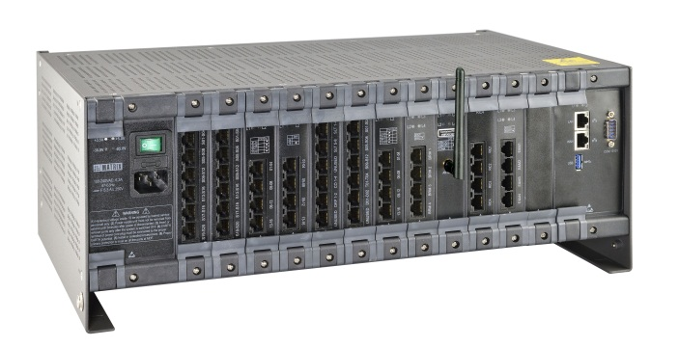
What Matrix has for Hotels
ETERNITY Hotel Phone Systems
For Small Hotels and Motels
with up to 40 Rooms
For Medium Hotels and Hospitals
with up to 200 Rooms/Beds
ETERNITY PE6S
ETERNITY GE6S
ETERNITY GE12S
For Large Hotels and Hospitals
with up to 1500 Rooms/Beds
ETERNITY LE
ETERNITY ME16S
ETERNITY GENX

Slide 16
Matrix ETERNITY Phone System
Matrix ETERNITY
A comprehensive Phone System for Hotels
Ideal for Hotels, Motels and Hospitals with up to 400 Rooms
Efficient call management features
Innovative guest services
Value added hospitality features
Support for leading PMS and CAS interfaces
Quick installation using innovative installation wizard
Built-in Front Desk Management Features
Platform Highlight
System Architecture
Digital 100% Non-Blocking
Universal Connectivity
CO-PSTN
VoIP and GSM
ISDN BRI/PRI, T1/E1
Auxiliary Ports
High Level of Integration
Third-party PMS and CAS, Voice Mail
Built-in Functionality
Hotel features, Auto-Attendant, Multi Channel Conferencing
Flexibility
Modular and field expandable design

Slide 17
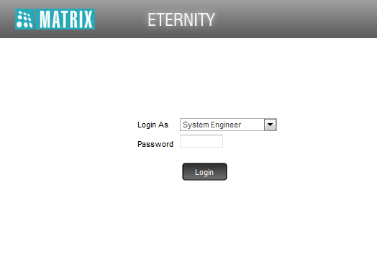
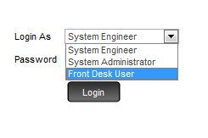
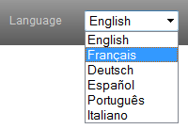
Matrix Front Desk Management
Hotel Software – Overview
Built-in Comprehensive set of Hotel Features
No Need of additional application for Receptionist/Front desk executive
Easy Installation Wizard
Real-time information display e.g. guest room status, service staff, alarms, etc.
Works easily with 3rd party PMS and CAS (over COM port and Ethernet port)
Web-based configuration and operation
Multi-language Support

Slide 18
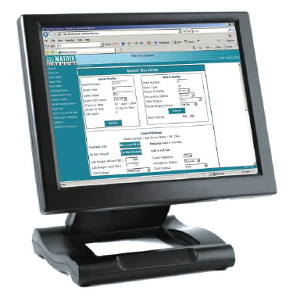
Matrix Front Desk Management
Hotel Software Features
Helps to perform guest management functions such as:
Guest Check-in/Check-out
Set/Cancel Wake-up calls
Block/Allow Room-to-Room dialing
Set/Cancel Do-not-Disturb (DND) for the guests
Set/Cancel call forward for the guests
Enable/Disable message wait function
Print hotel reports
Wake-up calls, reminders, occupancy and room clean status
Print hotel-motel activity log
Re-print Check-out reports
Delete Call Details on Check-out
Shift guests from one room to another

Slide 19
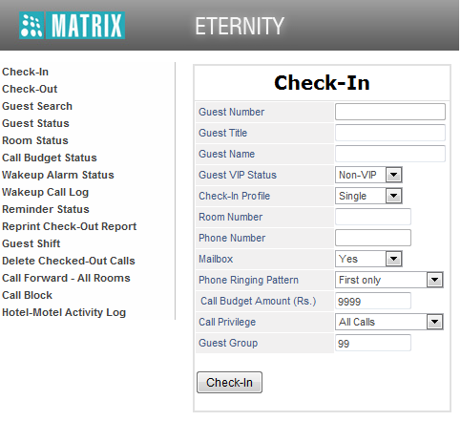
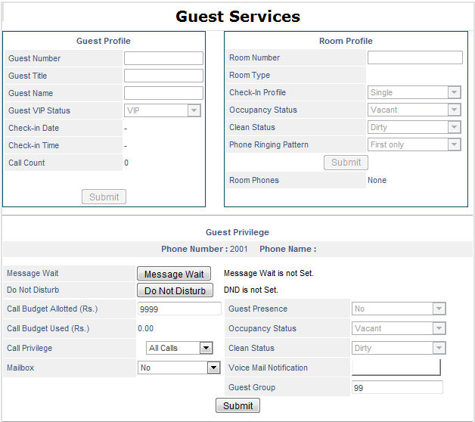
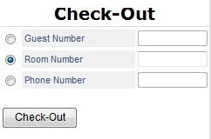
Matrix Front Desk Management

Slide 20
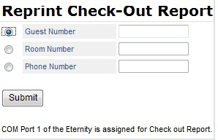
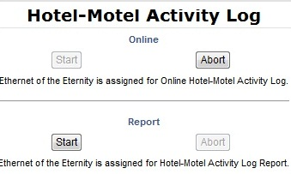
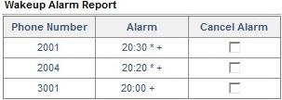
Matrix Front Desk Management

Slide 21
Matrix Front Desk Management
Check-in and Check-out
Check-in Profile
Room Types
Hotel Name
Guest Name and Title
Guest Number
Guest VIP status
Guest Search
Guest Shift
Alarms & Reminders
Wake-up Calls
Call Privilege
Call Budget
Call Forward
Call Block
Do Not Disturb (DND)
Occupancy status
Guest In/Out status
Maid In/Out status
Room clean status
Message Wait Indication
Voicemail
Mini Bar
Floor Service
Hotel-Motel Activity Log
Room status reports

Slide 22
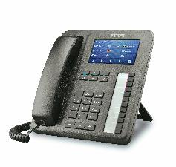
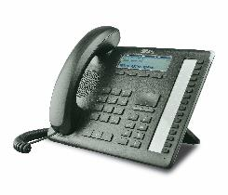
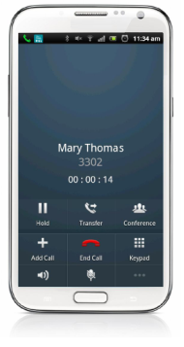
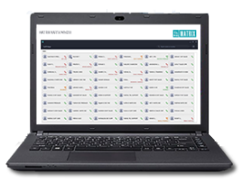
Matrix offers range of intuitive hotel terminals for each application
Operator Console
IP phone
Digital phones
Android/iOS Smartphones
UC Client
Analog phones

Slide 23
How Matrix helps to offer Value -added services with Single Investment

Slide 24
PMS Integration
Domestic PMS Integration
IDS
eZee Technosys
Winsar InfoSoft – WINHMS
Acumen Software – HOTSOFT
Power Brain – POWER HMS
RSI
Used by many domestic hotels with size up to 100 rooms
Mayfair Hotels and Resorts
Royal Orchid Hotels
Lords Hotels and Resorts
Ramada Worldwide
Sarovar Hotels and Resorts
Le Meridian Hotels and Resorts
* Logos are of respective PMS developer/manufacturer

Slide 25
PMS Integration
Global PMS Integration
Micros Opera - Fidelio
Protel
Auto Clerk
Char
Amadeus
RMS
Used by global and national hotel chains and Groups such as
TATA Hotels
ITC Hotels
The Leela Palace
Mantra Group
Hilton
Hyatt
Fairmont
Carlson
* Logos are of respective PMS developer/manufacturer

Slide 26
CAS Integration
ETERNITY supports 15 widely used posting protocols for CAS
ETERNITY also supports customization of the posting protocol to match the settings required by the CAS used by the hotel
Blind Send
Matrix
Holidex
HOBIS A
HOBIS B
HOBIC
BELL HOBIC
MICROS A
MICROS B
Hilton
Xiox
Comm One
Call-Inn RSI-CMS
Customized (protocol)

Slide 27
Voicemail Services
In-Skin Voicemail System
No need of external Voicemail device
No need of external Call Recording device
No need of external Auto-attendant device
Long term message record with PC transfer function
Voicemail Indication and Notification
Send guest Voicemail directly to guest E-mail
Greet callers with Personalized prompts
Customizable mailbox size
Voicemail Highlight
Attend up to 16 callers all together
Define mail boxes for up to 512 guests and hotel staff
Record conversation up to 576 hours
Use any USB flash drive for call recording and voicemail
Define Group and Individual mailboxes

Slide 28
Competitor Analysis

Slide 29
Competitor Analysis
Matrix Hospitality Solution | Other Hospitality Solutions
Lower Acquisition Cost | Higher Initial Purchase Cost
Free Software upgrades | Expensive software upgrades
Single Solution for Multiple Applications: CAS/PMS Integration, UC Clients, IP Telephony, Multi-Site Connectivity and more | Multiple Solutions required for Multiple Applications
Power Supply Card to manage complete system leads to effective power management and huge saving on power usage | Cabinet architecture consisting of multiple systems requiring multiple power source, leading to more power consumption and more maintenance costs
Compact footprint and consume less real estate | Cabinet architecture requiring more real estate and skilled man-power
Simplified licensing – no separate licensing for Collaboration client, i.e. Single license for SIP trunks, VoIP Channels, Matrix IP phones, 3rd Party IP Handsets, Mobile Softphones & UC Clients. | Separate Licenses for using SIP trunks, VoIP Channels, Collaboration Clients for 3rd Party IP Handsets such as Mobile Apps, Wi-Fi Handsets & PC Softphones
Emergency Messaging for Staff when Fire Alarms are activated | No such Broadcast Messaging features are available

Slide 30
Competitor Analysis
Matrix Hospitality Solution | Other Hospitality Solutions
Single user license required for PMS and CAS interfaces | Separate licenses for PMS & CAS interfaces increasing license cost
Future-Proof solution with Scalable and Universal Slot system for upcoming Latest Technologies such as VOIP calling and UC Consoles | Separate solutions for such upgrades with multiple licenses and high cost solutions
Built-in GSM trunks for back-ups | No GSM Connectivity
Built-in SMS Text Server for Marketing and Notifications | No SMS Capabilities
Built-in Call Reporting for Admin Phones | Require third party software or expensive own brand software for reporting
Built-in Call Recording Feature | Separate Charges for Basic Call Recording
Built-in Revenue Streaming for Each trunk – Call Costing for Smart Billing of Customers’ Calls | Requires third Party Software or Expensive own brand software for Revenue Streaming

Slide 31
Competitor Analysis
Matrix Hospitality Solution | Other Hospitality Solutions
Hot-Swapping and Redundancy features for Continuous working of the System | No such functionality is possible as there are multiple systems and all are linked together
Least Cost Routing algorithm to route calls through the most appropriate network, ensuring least possible telecom cost for each call | No such feature available, leading to high Initial cost, high upgradation cost, high license cost and high telecom cost
Ready Integration with World Renown CAS and PMS Integration such as Micros Opera, Protel, Auto Clerk, Char, Amadeus, RMS, IDS, RSI and many more | No such ready integration, requires separate set-up and licenses for these applications
Free Online 24 X 7 Support | Support is chargeable based on Cost per minute
Low Support and Maintenance costs | Very high support and maintenance costs
500+ Partners across the Globe giving us Presence in 40+ Countries | Limited Presence and reach
Presence and Reach in multiple countries leads to Quick Spare Support, Better Response Time, Better Customer Service and Satisfaction | As presence and Reach are limited, spare support and customer service is not that efficient

Slide 32
Some of Matrix References

Slide 33
Some of Matrix References
Domestic Hotel Customers
Cambay Hotels & Resorts
Hotel Jora Palace
Hotel International Residency
Hotel Le Grande
Hotel Maurya Rajdhani
Hotel Mogul Palace
Hotel Regal Palace
RAS Resorts
Royal Garden Resorts
Royal Orchid Hotels
The Travancore Heritage
Zoya Resorts
* Logos are of respective hotels

Slide 34
Some of Matrix References
International Hotel Customers
Hotel Cambiago, Cambiago, Italy
Hotel Posta,Como, Italy
Hotel Prati,Castrocaro Terme, Italy
Hotel Club Roccaruja,Stintino, Italy
Residence Il Mulinaccio,Pievepelago, Italy
Hotel Calvanella, Sestola, Italy
Hotel La Contrada, Verbania Intra, Italy
Hotel Alexandra Plaza,Riccione, Italy
Hotel Dynasty, Sassuolo, Italy
Hotel Mediterranee,Lungomare, Italy
Hotel Schiller,Cervia, Italy
Hotel Audi,Rimini, Italy
Hotel Elba, Rimini, Italy
* Logos are of respective hotels

Slide 35
For further information please contact:
Ronak.Sharma@MatrixComSec.com
+91 7227882400

